Slide 1
Project Phase 2
Due: April 25th
Logical Design:
ER to Relational Model Mapping
List of Functional Dependencies
Normalization
BCNF or 3NF
Report: Not less than 7 pages

Slide 2
4.4
Logical Database Design

Slide 3
Relational Database Design Algorithms

Slide 4
Outline
Algorithms for Relational Database Schema Design
Nulls, Dangling Tuples, Alternative Relational Designs
Multivalued Dependencies and Fourth Normal Form – further discussion
Other Dependencies and Normal Forms
Join Dependencies
Inclusion Dependencies
Dependencies based on Arithmetic Functions and Procedures
Domain-Key Normal Form

Slide 5
DESIGNING A SET OF RELATIONS (1)
The Approach of Relational Synthesis (Bottom-up Design):
Assumes that all possible functional dependencies are known.
First constructs a minimal set of FDs
Then applies algorithms that construct a target set of 3NF or BCNF relations.
Additional criteria may be needed to ensure the the set of relations in a relational database are satisfactory
(see Algorithm 15.3: Testing for Nonadditive Join Property).

Slide 6
DESIGNING A SET OF RELATIONS (2)
Goals:
Lossless join property (a must)
Algorithm 15.3 tests for general losslessness.
Dependency preservation property
Observe as much as possible
Algorithm 15.5 decomposes a relation into BCNF components by sacrificing the dependency preservation.
Additional normal forms
4NF (based on multi-valued dependencies)
5NF (based on join dependencies)

Slide 7
Properties of Relational Decompositions
Relation Decomposition and Insufficiency of Normal Forms:
Universal Relation Schema:
A relation schema R = {A1, A2, …, An} that includes all the attributes of the database.
Universal Relation Assumption:
Every attribute name is unique.
Decomposition:
The process of decomposing the universal relation schema R into a set of relation schemas D = {R1,R2, …, Rm} that will become the relational database schema by using the functional dependencies.
Attribute Preservation Condition:
Each attribute in R will appear in at least one relation schema R_{i} in the decomposition so that no attributes are “lost”.

Slide 8
Properties of Relational Decompositions
Another goal of decomposition is to have each individual relation R_{i} in the decomposition D be in BCNF or 3NF.
Additional properties of decomposition are needed to prevent from generating spurious tuples

Slide 9
Properties of Relational Decompositions
Dependency Preservation Property of a Decomposition
Definition:
Given a set of dependencies F on R, the projection of F on R_{i}, denoted by P_{Ri}(F) where R_{i} is a subset of R,
is the set of dependencies X  Y in F⁺ such that the attributes in X U Y are all contained in R_{i}.
Notes:
Hence, the projection of F on each relation schema R_{i} in the decomposition D is the set of functional dependencies in F⁺, the closure of F, such that all their left- and right-hand-side attributes are in R_{i}.

Slide 10
Properties of Relational Decompositions (cont)
Dependency Preservation Property:
A decomposition D = {R1, R2, ..., Rm} of R is dependency-preserving with respect to F if the union of the projections of F on each Ri in D is equivalent to F; i.e. ((π_{R1}(F)) υ (π_{R2}(F)). . . υ (π_{Rm}(F)))⁺ = F⁺
Claim 1:
It is always possible to find a dependency-preserving decomposition D with respect to F such that each relation R_{i} in D is in 3NF.

Slide 11
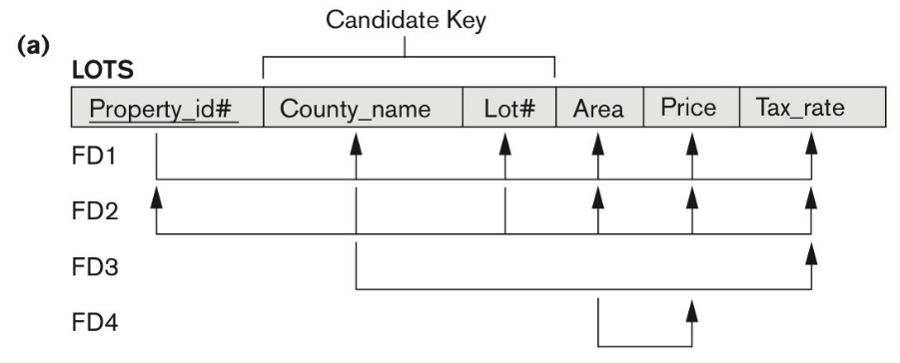
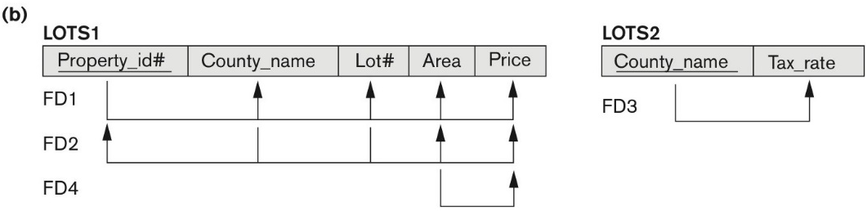
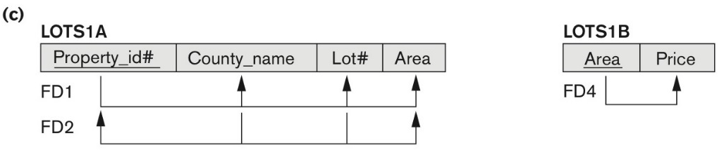
Exercise: Is Dependency Preserved

Slide 12
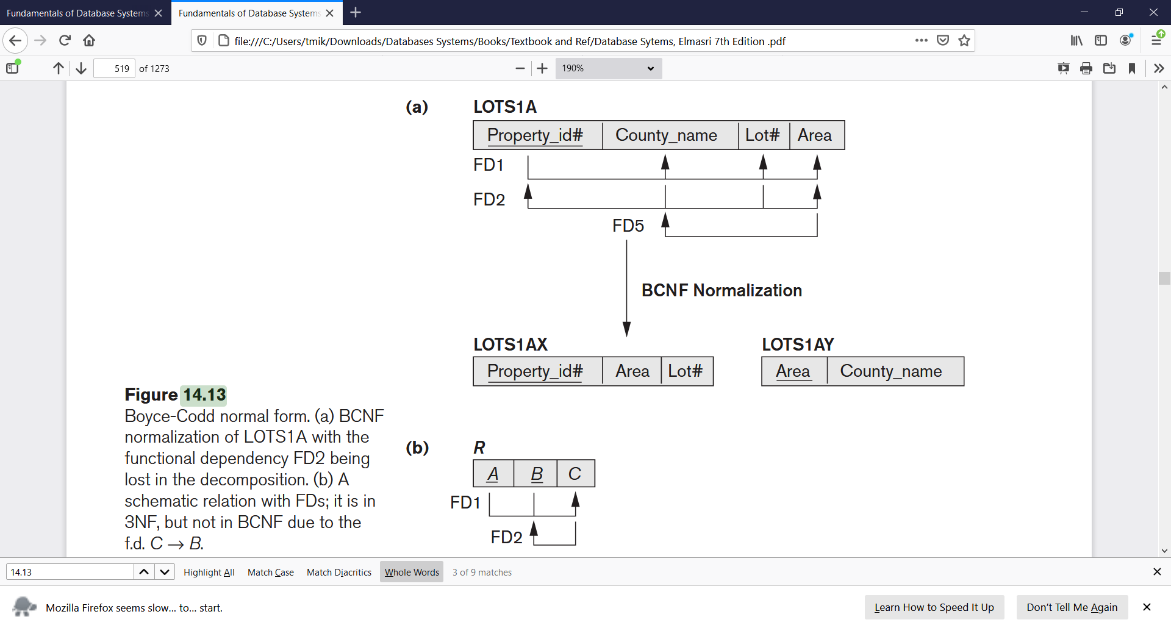
Exercise: Is Dependency Preserved
BCNF normalization of LOTS1A with the functional dependency FD2 being lost in the decomposition.

Slide 13

Exercise: Is Dependency Preserved
TEACH(student, course, Instructor)
FD1: {student, course} -> instructor
FD2: instructor -> course
R1(instructor, course)
Decomposed into
R2(instructor, student)
BCNF normalization of TEACH with the functional dependency FD1 being lost in the decomposition.

Slide 14
Properties of Relational Decompositions
Non-additive (Lossless) Join Property of a Decomposition:
Definition:
Lossless join property: a decomposition D = {R₁, R₂, ..., R_{m}} of R has the lossless (nonadditive) join property with respect to the set of dependencies F on R if,
for every relation state r of R that satisfies F, the following holds, where * is the natural join of all the relations in D:
* (π _{R1}(r), ..., π_{Rm}(r)) = r

Slide 15
Example: Is this Lossless?
R
R₁
R₂
A | B | C
1 | 1 | 1
2 | 1 | 2
3 | 2 | 1
4 | 3 | 2
A | B
1 | 1
2 | 1
3 | 2
4 | 3
B | C
1 | 1
1 | 2
2 | 1
3 | 2
Decompose
Natural Join
R₁
R₂
The word loss in lossless refers to loss of information, not to loss of tuples.
In fact, for “loss of information” a better term is “addition of spurious information”
A | B | C
1 | 1 | 1
1 | 1 | 2
2 | 1 | 1
2 | 1 | 2
3 | 2 | 1
4 | 3 | 2

Slide 16
Algorithm 15.3: Testing for Lossless Join Property
Input: A universal relation R, a decomposition D = {R₁, R₂, ..., R_{m}} of R, and a set F of functional dependencies.
1. Create an initial matrix S with one row i for each relation R_{i} in D, and one column j for each attribute A_{j} in R.
2. Set S(i, j):= b_{ij} for all matrix entries. (* each b_{ij} is a distinct symbol associated with indices (i, j) *).
3. For each row i representing relation schema R_{i}
{for each column j representing attribute A_{j}
{if (relation R_{i} includes attribute A_{j}) then set S(i, j):= a_{j};};};
(* each a_{j} is a distinct symbol associated with index (j) *)
CONTINUED on NEXT SLIDE

Slide 17
Algorithm 15.3: Testing for Lossless Join Property (continued)
4. Repeat the following loop until a complete loop execution results in no changes to S
{
for each functional dependency X Y in F
{
for all rows in S which have the same symbols in the columns corresponding to attributes in X
{
make the symbols in each column that correspond to an attribute in Y be the same in all these rows as follows:
If any of the rows has an “a” symbol for the column,
set the other rows to that same “a” symbol in the column.
If no “a” symbol exists for the attribute in any of the rows,
choose one of the “b” symbols that appear in one of the rows for the attribute and set the other rows to that same “b” symbol in the column ;
};
};
};
5. If a row is made up entirely of “a” symbols, then the decomposition has the lossless join property; otherwise it does not.

Slide 18
Example: Testing for Lossless Join Property
Consider the schema R=ABCD, FDs F= { A → B, B → C }, and Non-binary partition D1 = {ACD, AB, BC}. Is D1 lossless?
1. Create a matrix with one row i for each relation R_{i} , and one column j for each attribute A_{j}
 | A | B | C | D
ACD | b11 | b12 | b13 | b14
AB | b21 | b22 | b23 | b24
BC | b31 | b32 | b33 | b34
 | A | B | C | D
ACD | a1 | b12 | a3 | a4
AB | a1 | a2 | b23 | b24
BC | b31 | a2 | a3 | b34
2. Set S(i, j):= b_{ij} for all matrix entries
3. if r_{i} includes attribute a_{j}, replace b_{ij} with a_{j}
 | A | B | C | D
ACD | a1 | b12 | a3 | a4
AB | a1 | a2 | b23 | b24
BC | b31 | a2 | a3 | b34
 | A | B | C | D
ACD | a1 | a2 | a3 | a4
AB | a1 | a2 | b23 | b24
BC | b31 | a2 | a3 | b34
4. Apply FDs: A→B and B→C
5. First row is all a’s.
Conclusion: D1 = {ACD, AB, BC} is lossless.
Question Is D1 a Lossless decomposition?

Slide 19
Example: Testing for Lossless Join Property (continued)
R = {Ssn, Ename, Pnumber, Pname, Plocation, Hours}
F = {
Ssn→ Ename;
Pnumber→{Pname, Plocation};
{Ssn, Pnumber} →Hours
}
D = {R1, R2 }
R1 = EMP_LOCS = {Ename, Plocation}
R2 = EMP_PROJ1 = {Ssn, Pnumber, Hours, Pname, Plocation}
R | Ssn | Ename | Pnumber | Pname | Plocation | Hours
R1 | b11 | a2 | b13 | b14 | a5 | b16
R2 | a1 | b22 | a3 | a4 | a5 | a6
(No changes to matrix after applying functional dependencies

Slide 20
Example: Testing for Lossless Join Property
Consider the schema R(A,B,C,D) and FDs { A→B, B→C }, and the Non-binary partition D2 = {AB, BC, CD}. Is D2 lossless?
1. Create a matrix with one row i for each relation R_{i} , and one column j for each attribute A_{j}
 | A | B | C | D
AB | b11 | b12 | b13 | b14
BC | b21 | b22 | b23 | b24
CD | b31 | b32 | b33 | b34
 | A | B | C | D
AB | a1 | a2 | b13 | b14
BC | b21 | a2 | a3 | b24
CD | b31 | b32 | a3 | a4
2. Set S(i, j):= b_{ij} for all matrix entries
3. if r_{i} includes attribute a_{j}, replace b_{ij} with a_{j}
 | A | B | C | D
AB | a1 | a2 | b13 | b14
BC | b21 | a2 | a3 | b24
CD | b31 | b32 | a3 | a4
 | A | B | C | D
AB | a1 | a2 | a3 | b14
BC | b21 | a2 | a3 | b24
CD | b31 | b32 | a3 | a4
4. Apply FDs: A→B and B→C
5. No row contains all a’s
Conclusion: D2 = {AB, BC, CD} is not lossless.
Question Is D1 a Lossless decomposition?

Slide 21
Example: Testing for Lossless Join Property (continued)
R = {Ssn, Ename, Pnumber, Pname, Plocation, Hours}
F = {Ssn→ Ename; Pnumber→{Pname, Plocation}; {Ssn, Pnumber} →Hours}
R1 = EMP = {Ssn, Ename}
D = {R1, R2, R3 }
R2 = PROJ = {Pnumber, Pname, Plocation}
R2 = PROJ = {Ssn, Pnumber, Hours}
R | Ssn | Ename | Pnumber | Pname | Plocation | Hours
R1 | a1 | a2 | b13 | b14 | b15 | b16
R2 | b21 | b22 | a3 | a4 | a5 | b26
R3 | a1 | b32 | a3 | b34 | b35 | a6
Apply the first two functional dependencies
R | Ssn | Ename | Pnumber | Pname | Plocation | Hours
R1 | a1 | a2 | b13 | b14 | b15 | b16
R2 | b21 | b22 | a3 | a4 | a5 | b26
R3 | a1 | B32 a2 | a3 | B34 a4 | B35 a5 | a6
Last row is all “a” symbols so we stop

Slide 22
Testing Binary Decompositions for Non-additive Join (Lossless Join) Property
Algorithm 15.3 allows us to test whether a particular decomposition D into n relations obeys the non-additive join property with respect to a set of functional dependencies.
There is a special case of a decomposition called a binary decomposition
decomposition of a relation R into two relations.
It was used to do binary decom-position of the TEACH relation, which met 3NF but did not meet BCNF, into two relations that satisfied this property.
In the next slide we will se the NJB property test, which is easier to apply than Algorithm 15.3 but is limited only to binary decompositions.

Slide 23
Testing Binary Decompositions for Non-additive Join (Lossless Join) Property
Binary Decomposition: Decomposition of a relation R into two relations.
PROPERTY NJB (non-additive join test for binary decompositions):
A decomposition D = {R1, R2} of R has the lossless join property with respect to a set of functional dependencies F on R if and only if either
The FD. ((R1 ∩ R2)  (R1- R2)) is in F⁺, or
The FD. ((R1 ∩ R2)  (R2 - R1)) is in F⁺.

Slide 24
NJB
NJB (non-additive join test for binary decompositions
Example:
R(A,B,C,D) and FDs = { A→B, C→D }.
Evaluate the following binary partitions
 | R₁ ∩ R₂ | R1 – R2 | R2 – R1 | Lossless?
{AB, CD}
{ABC, CD}
{BD, ACD}
φ
AB
CD
No
C
AB
D
Yes: C→D
D
B
AC
No

Slide 25
Properties of Relational Decompositions
Successive Non-additive Join Decomposition
Claim 2 (Preservation of non-additivity in successive decompositions):
If a decomposition D = {R1, R2, ..., Rm} of R has the lossless (non-additive) join property with respect to a set of functional dependencies F on R, and
if a decomposition Di = {Q1, Q2, ..., Qk} of Ri has the lossless (non-additive) join property with respect to the projection of F on Ri,
then the decomposition D2 = {R1, R2, ..., Ri-1, Q1, Q2, ..., Qk, Ri+1, ..., Rm} of R has the non-additive join property with respect to F.

Slide 26
Algorithm to determine the key of a relation
Algorithm 15.2a Finding a Key K for R, given a set F of Functional Dependencies
Input: A universal relation R and a set of functional dependencies F on the attributes of R.
1. Set K := R;
2. For each attribute A in K {
Compute (K - A)⁺ with respect to F;
If {K – A}⁺ contains all the attributes in R,
then set K := K - {A};
}

Slide 27
Example
Set K := R;
For each attribute A in K {
Compute (K - A)⁺ with respect to F;
If {K – A}⁺ contains all the attributes in R, then set K := K - {A};
}
Determine the key of the relation R(A, B, C, D, E, F, G, H)
FD (ABC→DE, E→GH, H→G, G→H, ABCD→EF )
1. Key = ABCDEFGH
Key = ABCDEFGH
Key = ABCFGH
Key = ABCF
Key = ABC
Key = ABC
Prime Attributes {A, B, C}
Non-Prime Attributes {D, E, F, G, H}
Notes:
E→GH

Slide 28
Algorithm: Relational Synthesis into 3NF with Dependency Preservation and Non-Additive (Lossless) Join Property
Input:
A universal relation R and a set of functional dependencies F on the attributes of R.
1. Find a minimal cover G for F (use Algorithm 15.0).
2. For each left-hand-side X of a functional dependency that appears in G,
create a relation schema in D with attributes {X υ {A1} υ {A2} ... υ {Ak}},
where X  A1, X  A2, ..., X →Ak are the only dependencies in G with X as left-hand-side (X is the key of this relation).
3. If none of the relation schemas in D contains a key of R, then create one more relation schema in D that contains attributes that form a key of R.
4. Eliminate redundant relations from the resulting set of relations in the relational database schema. A relation R is considered redundant if R is a projection of another relation S in the schema; alternately, R is subsumed by S.

Slide 29
Algorithms for Design of 3NF Schema
1. Find a minimal cover G for F
2. For each X  A1, X  A2, ..., create a relation with attributes {X υ {A1} υ {A2} ...
3. If none of the newly created schemas contains a key of R, then create one more relation schema in D that contains attributes that form a key of R.
4. Eliminate redundant relations
R (Emp_ssn, Pno, Esal, Ephone, Dno, Pname, Plocation) FD1: Emp_ssn → {Esal, Ephone, Dno} FD2: Pno → { Pname, Plocation} FD3: Emp_ssn, Pno → {Esal, Ephone, Dno, Pname, Plocation}
1. Minimal Cover: {Emp_ssn → {Esal, Ephone, Dno}; Pno → Pname, Plocation}
2. Create a relation with attributes {X υ {A1} υ {A2} ... υ {Ak}}
2.1 Emp_ssn → {Esal, Ephone, Dno} ; R1(Emp_ssn, Esal, Ephone, Dno)
2.2 Pno → Pname, Plocation}; R2(Pno, Pname, Plocation)
3. None of the newly created schemas contains a key of R; hence R3 (Emp_ssn, Pno)

Slide 30
Algorithms for Design of 3NF Schema
1. Find a minimal cover G for F
2. For each X  A1, X  A2, ..., create a relation with attributes {X υ {A1} υ {A2} ...
3. If none of the newly created schemas contains a key of R, then create one more relation schema in D that contains attributes that form a key of R.
4. Eliminate redundant relations
U (Property_id, County, Lot#, Area)
FD1: Property_id → Lot#, County, Area
FD2: Lot#, County → Area, Property_id
FD3: Area → County
U (P, C, L, A)
FD1: P → LCA,
FD2: LC → AP,
FD3: A → C
1. Minimal Cover:
F_{C1}: {P → LC, LC → AP, A → C} F_{C2}: {P → LA, LC → P, A → C}
2. Create a relation
2.1 R1 (P, L, C), 2.2 R2 (L, C, A, P)
2.3 R3 (A, C)
3. Do nothing
4. R3 is a projection of R2 (R3 is subsumed by R2)
R1 is a projection of R2
Thus the 3NF schema that achieves both of the desirable properties is (after removing redundant relations)
R=R2 (L, C, A, P)

Slide 31
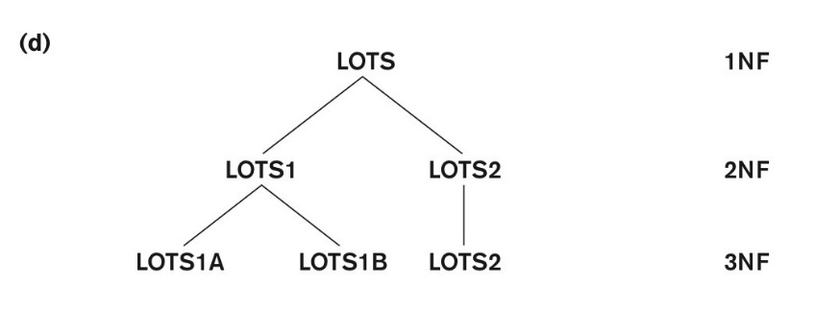
Normalization into 2NF and 3NF
(a) The LOTS relation with its functional dependencies FD1 through FD4.
(b) Decomposing into the 2NF relations LOTS1 and LOTS2.
(c) Decomposing LOTS1 into the 3NF relations LOTS1A and LOTS1B.
(d) Progressive normalization of LOTS into a 3NF design.

Slide 32
Algorithms for Design of 3NF Schema
1. Find a minimal cover G for F
2. For each X  A1, X  A2, ..., create a relation with attributes {X υ {A1} υ {A2} ...
3. If none of the newly created schemas contains a key of R, then create one more relation schema in D that contains attributes that form a key of R.
4. Eliminate redundant relations
U (Property_id, County, Lot#, Area)
FD1: Property_id → Lot#, County, Area
FD2: Lot#, County → Area, Property_id
FD3: Area → County
U (P, C, L, A)
FD1: P → LCA,
FD2: LC → AP,
FD3: A → C
1. Minimal Cover:
F_{C1}: {P → LC, LC → AP, A → C}
1. Minimal Cover:
F_{C2}: {P → LA, LC → P, A → C}
2. Create a relation
2.1 R1(P, L, A)
2.2 R2(L, C, P)
2.3 R3(A, C)
R=R2 (L, C, A, P)
3. Do nothing
4. Do nothing
R1(P, L, A); R2(L, C, P); R3(A, C)

Slide 33
3NF vs BCNF
R (Property_id, County, Lot#, Area)
FD1: Property_id → Lot#, County, Area
FD2: {Lot#, County} → Area, Property_id
FD3: Area → County
R1(P, L, A);
R3(A, C)
What about R2
R2(L, C, P);
3NF: R2 preserves the functional dependency FD2
BCNF: R2 is redundant.

Slide 34
Algorithm 15.5: Relational Decomposition into BCNF with Lossless (non-additive) join property
Input:
A universal relation R and a set of functional dependencies F on the attributes of R.
1. Set D := {R};
2. While there is a relation schema Q in D that is not in BCNF
do {
choose a relation schema Q in D that is not in BCNF;
find a functional dependency X  Y in Q that violates BCNF;
replace Q in D by two relation schemas (Q - Y) and (X U Y);
};
Assumption: No null values are allowed for the join attributes.

Slide 35
Algorithms for BCNF Schema Design
1. Set D := {R};
2. While there is a relation schema Q in D that is not in BCNF
do {
choose a relation schema Q in D that is not in BCNF;
find a functional dependency X  Y in Q that violates BCNF;
replace Q in D by two relation schemas (Q - Y) and (X U Y);
};
TEACH(Student, Course, Instructor)
FD1: {Student, Course} → Instructor
FD2: Instructor → Course
1. D(Student, Course, Instructor)
2. Q(Student, Course, Instructor)
2.1. (Q-Course) = R1(Student, Instructor)
2.2. (Instructor U Course)= R2(Course, Instructor)
TEACH1(Instructor, Student)
TEACH2(Instructor, Course)

Slide 36
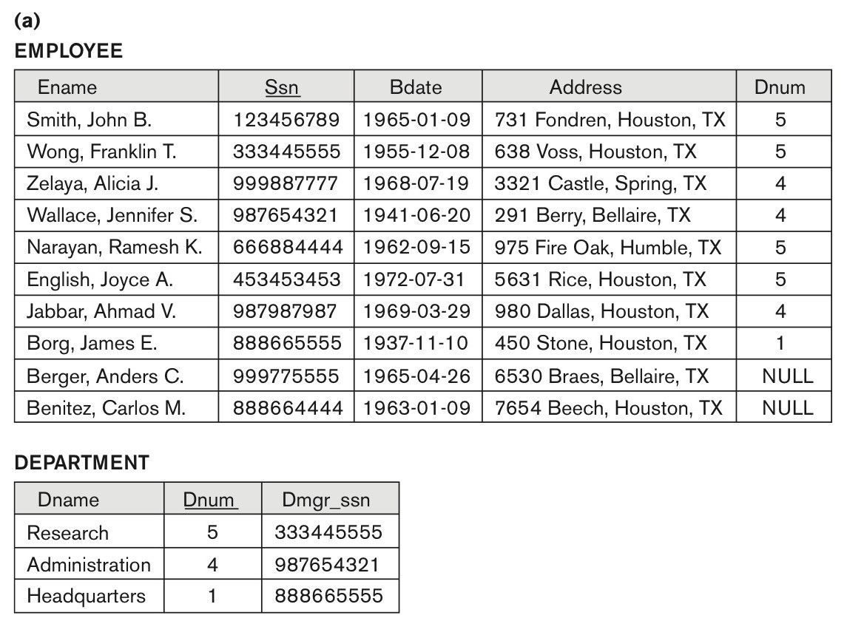
Problems with Null Values and Dangling Tuples
Some EMPLOYEE tuples have NULL for the join attribute Dnum.

Slide 37
Problems with Null Values and Dangling Tuples
Problems with NULL values
when some tuples have NULL values for attributes that will be used to join individual relations in the decomposition that may lead to incomplete results.
Previous slide, where two relations EMPLOYEE and DEPARTMENT are shown. The last two employee tuples:
‘Berger’ and ‘Benitez’ represent newly hired employees who have not yet been assigned to a department (assume that this does not violate any integrity constraints).

Slide 38
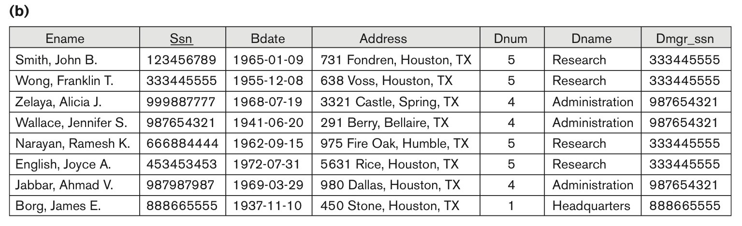
Problems with Null Values and Dangling Tuples
To retrieve a list of (Ename, Dname) values for all the employees.
If we apply the NATURAL JOIN operation on EMPLOYEE and DEPARTMENT, the two aforementioned tuples will not appear in the result.

Slide 39
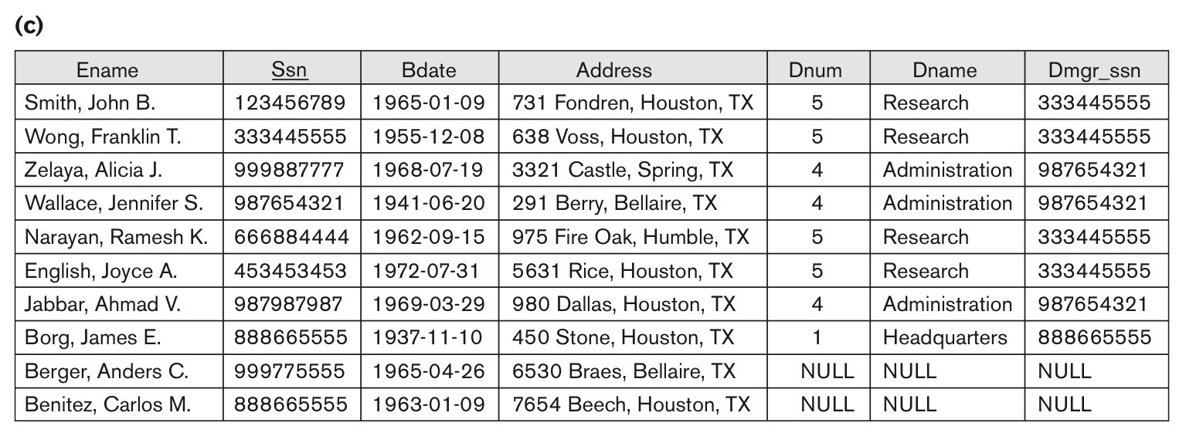
Problems with Null Values and Dangling Tuples (3)
To retrieve a list of (Ename, Dname) values for all the employees.
If we apply the LEFT OUTER JOIN operation on EMPLOYEE and DEPARTMENT, the result is shown below.

Slide 40
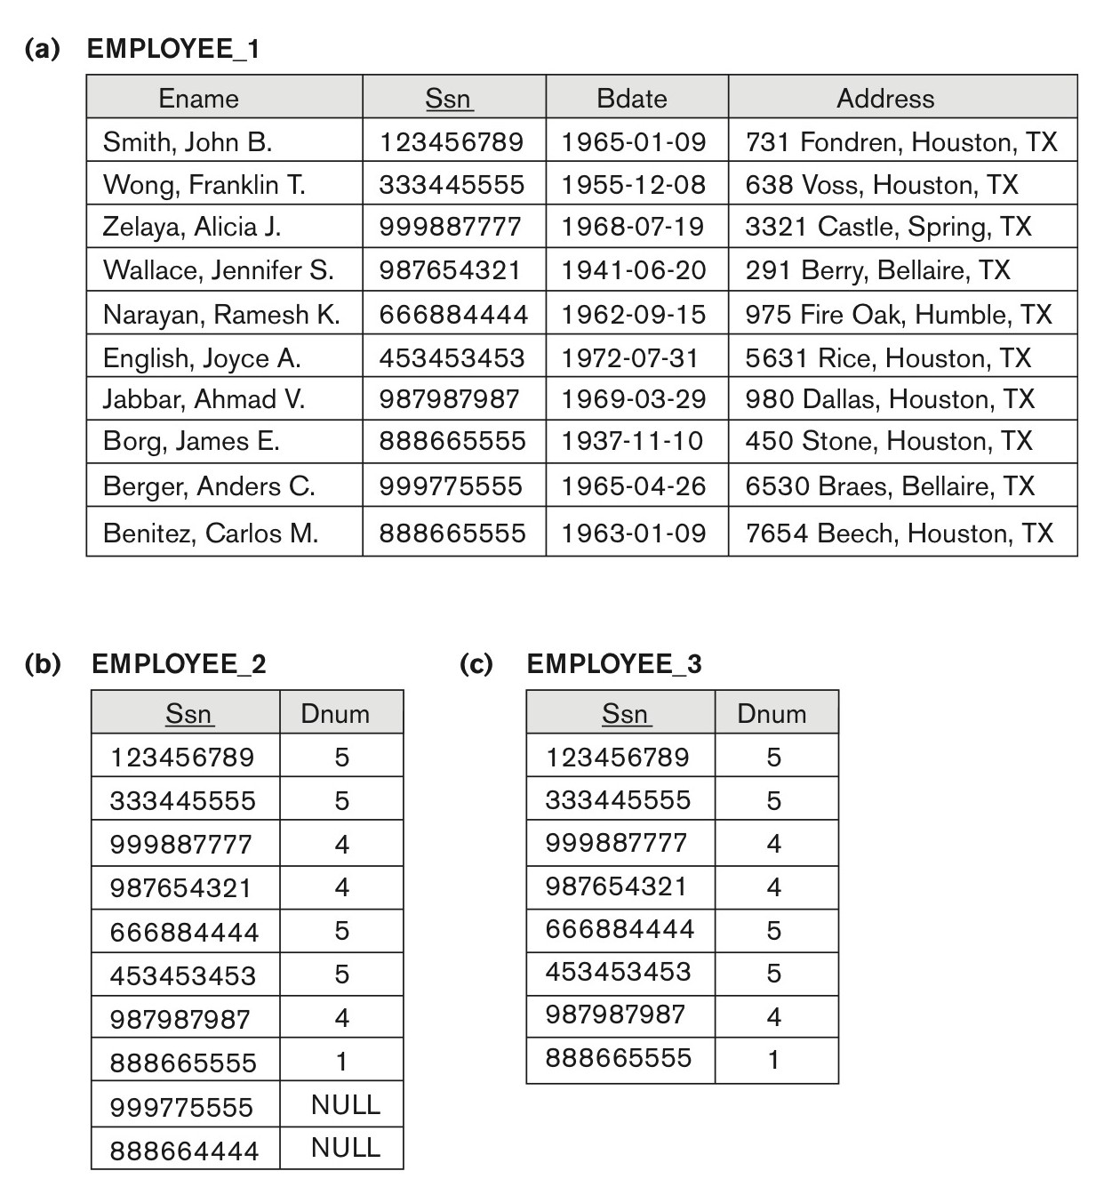
Problems with Null Values and Dangling Tuples
The relation EMPLOYEE_1 (includes all attributes of EMPLOYEE from Figure 15.2(a) except Dnum).
(b) The relation EMPLOYEE_2 (includes Dnum attribute with NULL values).
(c) The relation EMPLOYEE_3 (includes Dnum attribute but does not include tuples for which Dnum has NULL values).

Slide 41
Problems with Null Values and Dangling Tuples
Problems with Dangling Tuples
Consider the decomposition of EMPLOYEE into EMPLOYEE_1 and EMPLOYEE_2 as shown in previous slide.
Their NATURAL JOIN yields the original relation EMPLOYEE in Figure (a).
We may use the alternative representation, shown in Figure (c), where we do not include a tuple in EMPLOYEE_3 if the employee has not been assigned a department (instead of including a tuple with NULL for Dnum as in EMPLOYEE_2).
If we use EMPLOYEE_3 instead of EMPLOYEE_2 and apply a NATURAL JOIN on EMPLOYEE_1 and EMPLOYEE_3, the tuples for Berger and Benitez will not appear in the result; these are called dangling tuples in EMPLOYEE.

Slide 42
About Normalization Algorithms
Discussion of Normalization Algorithms:
Problems:
The database designer must first specify all the relevant functional dependencies among the database attributes.
These algorithms are not deterministic in general.
It is not always possible to find a decomposition into relation schemas that preserves dependencies and allows each relation schema in the decomposition to be in BCNF (instead of 3NF as in Algorithm 15.5).

Slide 43
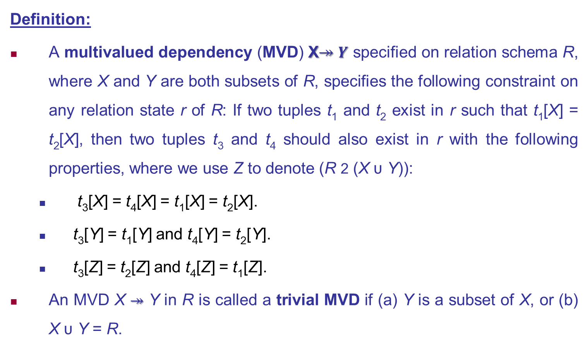
Fourth Normal Form Revisited
Definition:
A multivalued dependency (MVD) X$↠Y$ specified on relation schema R, where X and Y are both subsets of R, specifies the following constraint on any relation state r of R: If two tuples t₁ and t₂ exist in r such that t₁[X] = t₂[X], then two tuples t₃ and t₄ should also exist in r with the following properties, where we use Z to denote (R 2 (X υ Y)):
t₃[X] = t₄[X] = t₁[X] = t₂[X].
t₃[Y] = t₁[Y] and t₄[Y] = t₂[Y].
t₃[Z] = t₂[Z] and t₄[Z] = t₁[Z].
An MVD X $↠$ Y in R is called a trivial MVD if (a) Y is a subset of X, or (b) X υ Y = R.

Slide 44
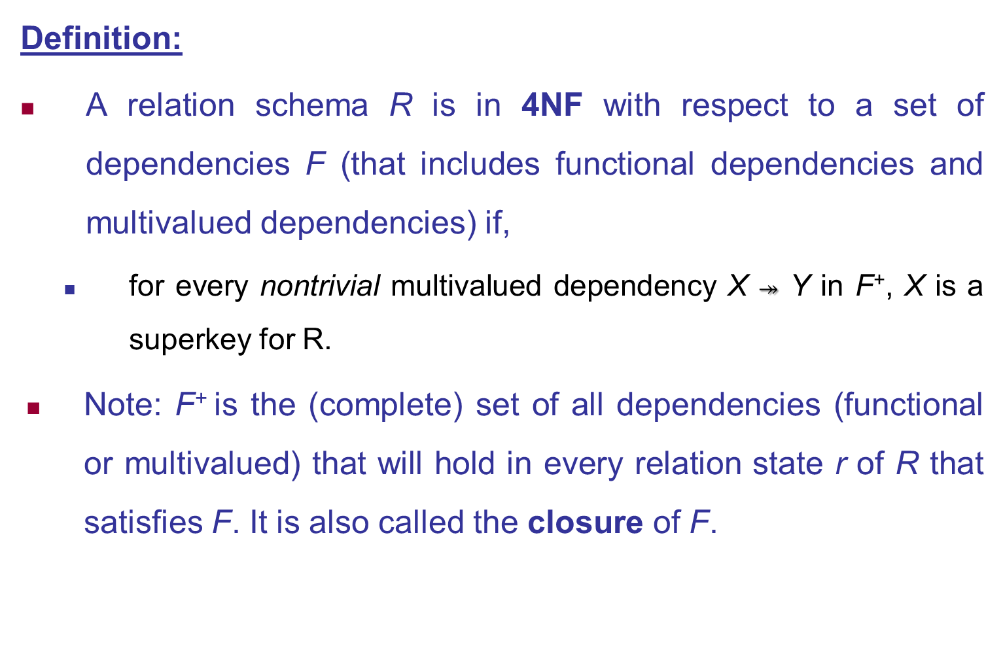
Multivalued Dependencies and Fourth Normal Form
Definition:
A relation schema R is in 4NF with respect to a set of dependencies F (that includes functional dependencies and multivalued dependencies) if,
for every nontrivial multivalued dependency X $↠$ Y in F⁺, X is a superkey for R.
Note: F⁺ is the (complete) set of all dependencies (functional or multivalued) that will hold in every relation state r of R that satisfies F. It is also called the closure of F.

Slide 45
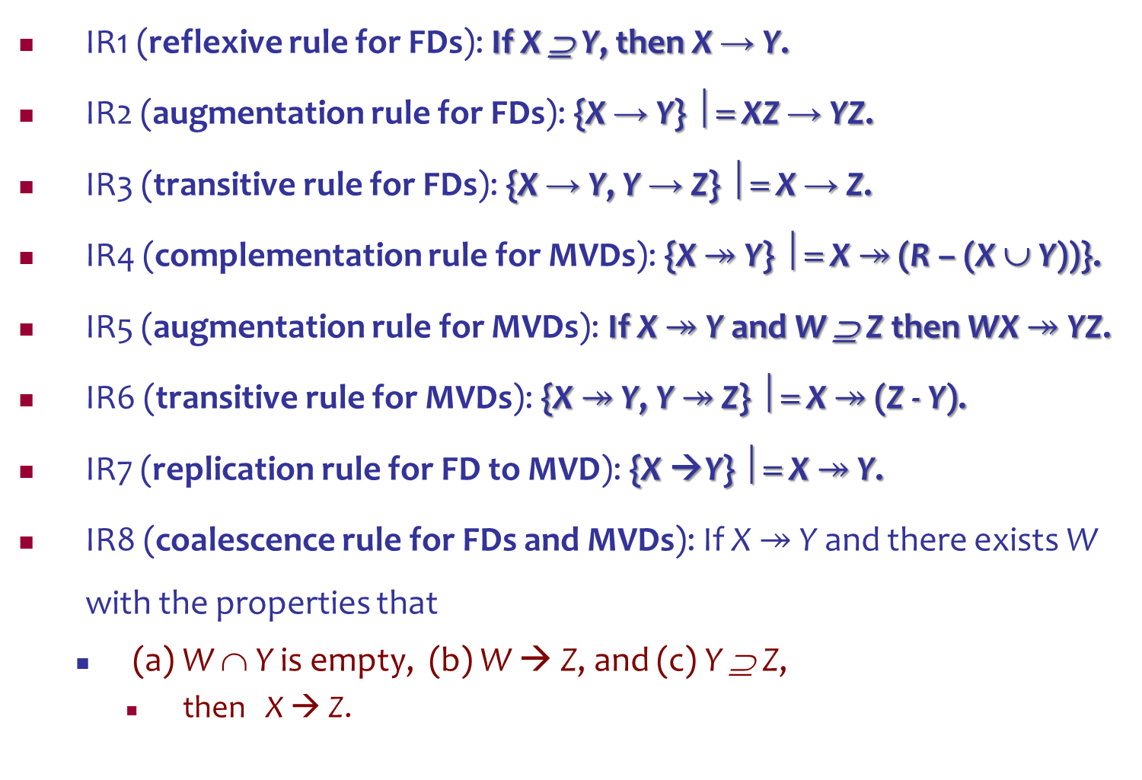
Inference Rules for Functional and Multivalued Dependencies
IR1 (reflexive rule for FDs): If X ⊇ Y, then X → Y.
IR2 (augmentation rule for FDs): {X → Y} ⏐= XZ → YZ.
IR3 (transitive rule for FDs): {X → Y, Y → Z} ⏐= X → Z.
IR4 (complementation rule for MVDs): {X $↠$ Y} ⏐= X $↠$ (R – (X ∪ Y))}.
IR5 (augmentation rule for MVDs): If X $↠$ Y and W ⊇ Z then WX $↠$ YZ.
IR6 (transitive rule for MVDs): {X $↠$ Y, Y $↠$ Z} ⏐= X $↠$ (Z - Y).
IR7 (replication rule for FD to MVD): {X →Y} ⏐= X $↠$ Y.
IR8 (coalescence rule for FDs and MVDs): If X $↠$ Y and there exists W with the properties that
(a) W ∩ Y is empty, (b) W → Z, and (c) Y ⊇ Z,
then X → Z.

Slide 46
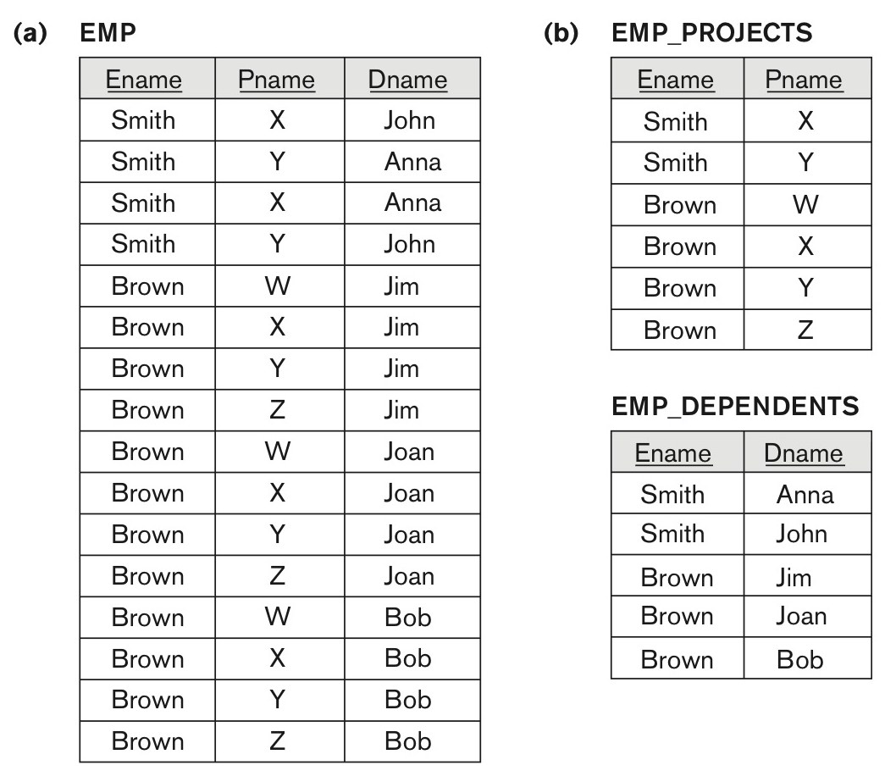
Multivalued Dependencies and Fourth Normal Form
Decomposing a relation state of EMP that is not in 4NF.
(a) EMP relation with additional tuples.
(b) Two corresponding 4NF relations EMP_PROJECTS and EMP_DEPENDENTS.

Slide 47
Multivalued Dependencies and Fourth Normal Form
5.3 Non-additive( Lossless) Join Decomposition into 4NF Relations:
PROPERTY NJB’
The relation schemas R₁ and R₂ form a lossless (non-additive) join decomposition of R with respect to a set F of functional and multivalued dependencies if and only if
(R₁ ∩ R₂) → (R₁ - R₂)
or by symmetry, if and only if
(R₁ ∩ R₂) → (R₂ - R₁)).

Slide 48
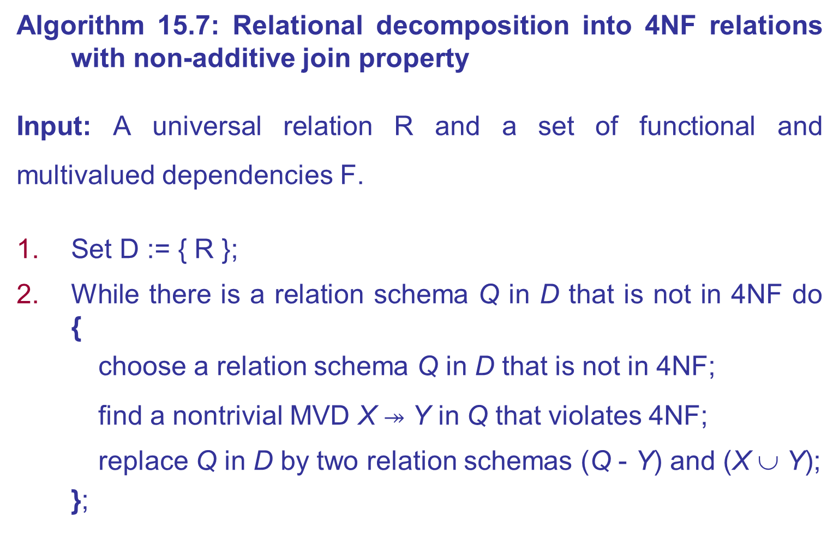
Multivalued Dependencies and Fourth Normal Form
Algorithm 15.7: Relational decomposition into 4NF relations with non-additive join property
Input: A universal relation R and a set of functional and multivalued dependencies F.
Set D := { R };
While there is a relation schema Q in D that is not in 4NF do {
choose a relation schema Q in D that is not in 4NF;
find a nontrivial MVD X $↠$ Y in Q that violates 4NF;
replace Q in D by two relation schemas (Q - Y) and (X ∪ Y);
};

Slide 49



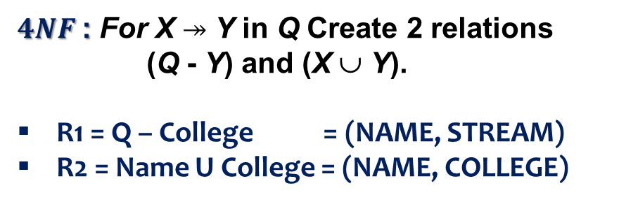
Example: 4NF
Suppose you want to record student applications with first and second stream choices at different universities
NAME | COLLEGE | STREAM
Abebe | AAiT | COMPUTER
Abebe | ASTU | POWER
Abebe | AAiT | POWER
Abebe | ASTU | COMPUTER
John | AAiT | COMPUTER
John | ASTU | POWER
John | AAiT | POWER
John | ASTU | COMPUTER
Kebede | AAiT | COMPUTER
Kebede | ASTU | POWER
Kebede | AAiT | POWER
Kebede | ASTU | COMPUTER
… | … | …
$MVD: NAME ↠COLLEGE$
$4NF$: For X $↠$ Y in Q Create 2 relations (Q - Y) and (X ∪ Y).
R1 = Q – College = (NAME, STREAM)
R2 = Name U College = (NAME, COLLEGE)
$$R1\left(NAME, STREAM\right)$$
$$R2\left(NAME, COLLEGE\right)$$
NAME | STREAM
Abebe | COMPUTER
Abebe | POWER
John | COMPUTER
John | POWER
Kebede | COMPUTER
Kebede | POWER
NAME | COLLEGE
Abebe | AAiT
Abebe | ASTU
John | AAiT
John | ASTU
Kebede | AAiT
Kebede | ASTU

Slide 50

Exercise
$$Yes$$
Is there any multivalued dependency
Course | Teacher | Book
Database Systems | Abebe | Elmasri, Navathe: Fundamentals of DB Systems
Database Systems | Abebe | Silbershatz, Korth, Sudarshan: DB Sys concepts
Database Systems | Abebe | Raghu Ramakrishnan …: DB Mang’t Sys
Database Systems | John | Elmasri, Navathe: Fundamentals of DB Systems
Database Systems | John | Silbershatz, Korth, Sudarshan: DB Sys concepts
Database Systems | John | Raghu Ramakrishnan …: DB Mang’t Sys
R1(Course, Book)
R2(Course, Teacher)
Course | Teacher
Database Systems | Abebe
Database Systems | John
Course | Book
Database Systems | Elmasri, Navathe: Fundamentals of DB Systems
Database Systems | Silbershatz, Korth, Sudarshan: DB Sys concepts
Database Systems | Raghu Ramakrishnan …: DB Mang’t Sys

Slide 51
Join Dependency (JD) Revisited
Definition:
A join dependency (JD), denoted by JD(R₁, R₂, ..., R_{n}), specified on relation schema R, specifies a constraint on the states r of R.
The constraint states that every legal state r of R should have a non-additive join decomposition into R₁, R₂, ..., R_{n}; that is, for every such r we have * (π_{R1}(r), π_{R2}(r), ..., π_{Rn}(r)) = r
Note: an MVD is a special case of a JD where n = 2.
A join dependency JD(R₁, R₂, ..., R_{n}), specified on relation schema R, is a trivial JD if one of the relation schemas R_{i} in JD(R₁, R₂, ..., R_{n}) is equal to R.

Slide 52
Join Dependencies and Fifth Normal Form
Definition of 5NF:
A relation schema R is in fifth normal form (5NF) (or Project-Join Normal Form (PJNF)) with respect to a set F of functional, multivalued, and join dependencies if,
for every nontrivial join dependency JD(R₁, R₂, ..., R_{n}) in F⁺ (that is, implied by F),
every R_{i} is a superkey of R.
Discovering join dependencies in practical databases with hundreds of relations is next to impossible. Therefore, 5NF is rarely used in practice.

Slide 53
Inclusion Dependencies
Definition:
An inclusion dependency R.X < S.Y between two sets of attributes
X of relation schema R, and Y of relation schema S
specifies the constraint that, at any specific time when r is a relation state of R and s a relation state of S, we must have π_{X}(r(R)) ⊆ π_{Y}(s(S))
Note:
The ⊆ (subset) relationship does not necessarily have to be a proper subset.
The sets of attributes on which the inclusion dependency is specified (X of R and Y of S) must have the same number of attributes.
In addition, the domains for each pair of corresponding attributes should be compatible.

Slide 54
Objective of Inclusion Dependencies
To formalize two types of inter-relational constraints which cannot be expressed using F.D.s or MVDs:
Referential integrity constraints
Class/subclass relationships

Slide 55
Inclusion Dependency Inference Rules
IDIR1 (reflexivity):
R.X < R.X.
IDIR2 (attribute correspondence):
If R.X < S.Y where
X = {A₁, A₂ ,..., A_{n}} and
Y = {B₁, B₂, ..., B_{n}} and A_{i} Corresponds to B_{i},
then R.A_{i} < S.B_{i} for 1 ≤ i ≤ n.
IDIR3 (transitivity):
If R.X < S.Y and S.Y < T.Z, then R.X < T.Z.

Slide 56
Example
Inclusion dependencies - referential integrity constraints.
DEPARTMENT.Dmgr_ssn < EMPLOYEE.Ssn
WORKS_ON.Ssn < EMPLOYEE.Ssn
EMPLOYEE.Dnumber < DEPARTMENT.Dnumber
PROJECT.Dnum < DEPARTMENT.Dnumber
WORKS_ON.Pnumber < PROJECT.Pnumber
DEPT_LOCATIONS.Dnumber < DEPARTMENT.Dnumber
Inclusion dependencies to represent - class/subclass relationships.
EMPLOYEE.Ssn < PERSON.Ssn
ALUMNUS.Ssn < PERSON.Ssn
STUDENT.Ssn < PERSON.Ssn

Slide 57
Functional Dependencies based on Arithmetic functions
Arithmetic Functions:
As long as a unique value of Y is associated with every X, we can still consider that the FD X → Y exists.
For example, consider the relation:
ORDER_LINE (Order#, Item#, Quantity, Unit_price, Extended_price, Discounted_price)
In this relation (Quantity, Unit_price ) → Extended_price
Formula: Extended_price = Quantity * Unit_price.
Notes:
Hence, there is a unique value for Extended_price for every pair (Quantity, Unit_price ), and thus it conforms to the definition of functional dependency.

Slide 58
Functional Dependencies based on and procedures
Procedures:
There may be a procedure that takes into account the quantity discounts, the type of item, and so on and computes a discounted price for the total quantity ordered for that item. Therefore, we can say
(Item#, Quantity, Unit_price ) → Discounted_price, or
(Item#, Quantity, Extended_price) → Discounted_price.

Slide 59
Other Dependencies and Normal Forms (3)
Domain-Key Normal Form (DKNF):
Definition:
A relation schema is said to be in DKNF if all constraints and dependencies that should hold on the valid relation states can be enforced simply by enforcing the domain constraints and key constraints on the relation.
The idea is to specify (theoretically, at least) the “ultimate normal form” that takes into account all possible types of dependencies and constraints.
For a relation in DKNF, it becomes very straightforward to enforce all database constraints by simply checking that each attribute value in a tuple is of the appropriate domain and that every key constraint is enforced.
The practical utility of DKNF is limited

Slide 60
SUMMARY
Designing a Set of Relations by Synthesis
Properties of Relational Decompositions
Algorithms for Relational Database Schema Design in 3NF and BCNF
Multivalued Dependencies and Fourth Normal Form
Other Dependencies and Normal Forms

Slide 61
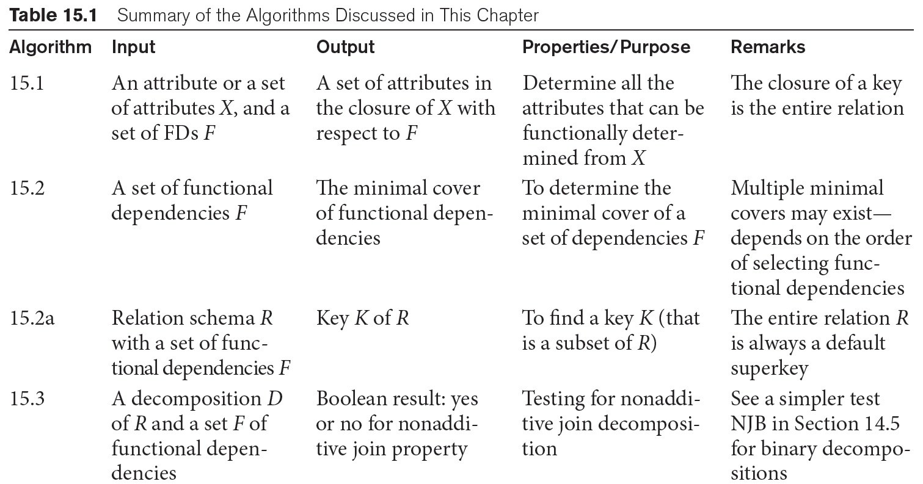
Summary of Algorithms for Relational Database Schema Design (see Table 15.1 - Summary of the Algorithms)

Slide 62
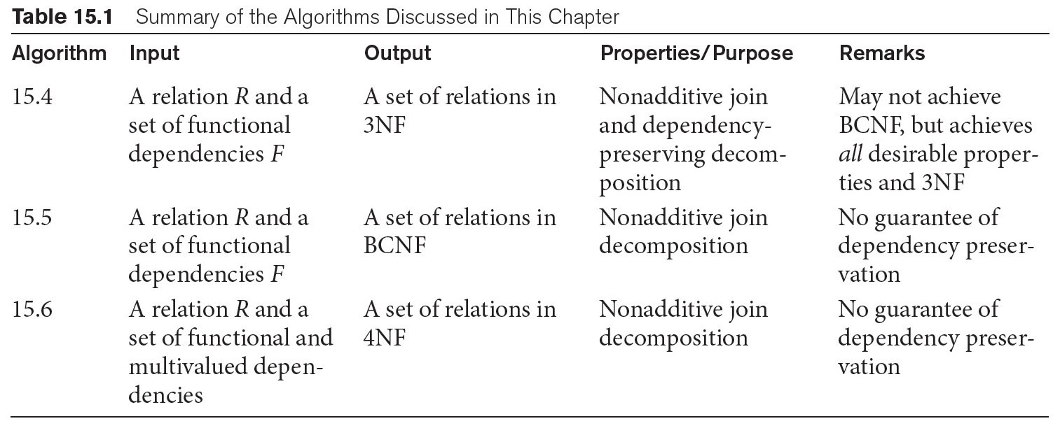
Summary of Algorithms for Relational Database Schema Design (see Table 15.1 - Summary of the Algorithms)

Slide 63
Example
Find the highest normal form
R(A, B, C, D, E, F, G, H)
FD (ABC→DE, E→GH, H→G, G→H, ABCD→EF )
Key = ABCDEFGH
Key = ABC
Prime Attributes {A, B, C}
Non-Prime Attributes {D, E, F, G, H}
FD (X → A) | ABC→DE | E→GH | H→G | G→H | ABCD→EF
X is a superkey
A is a prime attribute
Partial Dependency
YES
NO
NO
NO
NO
NO
NO
NO
NO
NO
NO
NO
NO
NO
NO
BCNF
3NF
2NF
1NF
Notes:
E→GH

Slide 64
Example
Find the highest normal form
R(A, B, C, D)
FD (AB→CD, AC→BD, BC→D )
Key = ABCD
Key = AB
Prime Attributes {A, B}
Non-Prime Attributes {C,D}
Key = AB = AAC
Key = AC
Key = AC = AAB = AB
BCNF
3NF
2NF
1NF
Candidate Keys
AB, AC
Prime Attributes {A, B, C}
Non-Prime Attributes {D}
FD (X → A) | AB→CD | AC→BD | BC→D
X is a superkey
A is a prime attribute
Partial Dependency
YES
YES
NO
NO
NO
NO
NO
NO
YES
Notes:
E→GH

Slide 65
Exercises
Consider the relation R, which has attributes that hold schedules of courses and sections at a university;
R = {Course_no, Sec_no, Offering_dept, Credit_hours, Course_level, Instructor_ssn, Semester, Year, Days_hours, Room_no, No_of_students}.
Suppose that the following functional dependencies hold on R:
{Course_no}→{Offering_dept, Credit_hours, Course_level}
{Course_no, Sec_no, Semester, Year}→{Days_hours, Room_no,No_of_students, Instructor_ssn}
{Room_no, Days_hours, Semester, Year}→{Instructor_ssn, Course_no, Sec_no}
Try to determine which sets of attributes form keys of R. How would you normalize this relation?

Slide 66
Exercises
Consider the following relation for published books:
BOOK (Book_title, Author_name, Book_type, List_price, Author_affil, Publisher)
Author_affil refers to the affiliation of author.
Suppose the following dependencies exist:
Book_title→Publisher, Book_type
Book_type→List_price
Author_name→Author_affil
What normal form is the relation in? Explain your answer.
Apply normalization until you cannot decompose the relations further. State the reasons behind each decomposition

Slide 67
Exercises
Consider the following relation:
CAR_SALE(Car#, Date_sold, Salesperson#, Commission%, Discount_amt)
Assume that a car may be sold by multiple salespeople, and hence {Car#, Salesperson#} is the primary key. Additional dependencies are:
Date_sold→Discount_amt
andSalesperson#→Commission%
Based on the given primary key, is this relation in 1NF, 2NF, or 3NF? Why or why not?
How would you successively normalize it completely?

Slide 68
Exercises
Consider the following relations for an order-processing application data-base at ABC, Inc.
ORDER (O#, Odate, Cust#, Total_amount)
ORDER_ITEM(O#, I#, Qty_ordered, Total_price, Discount%)
Assume that each item has a different discount. The Total_price refers to one item, Odate is the date on which the order was placed, and the Total_amountis the amount of the order.
If we apply a natural join on the relations ORDER_ITEM and ORDER in this database, what does the resulting relation schema RES look like?
What will be its key? Show the FDs in this resulting relation.
Is RES in 2NF? Is it in 3NF? Why or why not? State assumptions, if you make any.

Slide 69
Exercises
Consider the following relation that refers to business trips made by company sales people :
TRIP (Trip_id, Start_date, Cities_visited, Cards_used)
Suppose the TRIP has a single Start_date but involves many Cities and sales people may use multiple credit cards on the trip.
Make up a mock-up population of the table.
Discuss what FDs and/or MVDs exist in this relation.
Show how you will go about normalizing the relation.

Slide 70
Exercises
Consider the following relation (options installed in cars e.g., cruise control) that were sold at a dealership:
CAR_SALE (Car_id, Option_type, Option_listprice, Sale_date,Option_discountedprice)
Functional Dependencies:
CarID → Sale_date
Option_type → Option_listprice
{CarID, Option_type}→ Option_discountedprice
Argue using the generalized definition of the 3NF that this relation is not in 3NF. Then argue from your knowledge of 2NF, why it is not even in 2NF.

Slide 71
Exercises
Consider the following relation:
R (Doctor#, Patient#, Date, Diagnosis, Treat_code, Charge)
In the above relation, a tuple describes a visit of a patient to a doctor along with a treatment code and daily charge.
Assume that diagnosis is determined (uniquely) for each patient by a doctor.
Assume that each treatment code has a fixed charge (regardless of patient).
Is this relation in 2NF?
Justify your answer and decompose if necessary.
Then argue whether further normalization to 3NF is necessary, and if so, perform it.

Slide 72
Exercises
Consider the following relation:
A | B | C | TUPLE#
10 | b1 | C1 | 1
10 | B2 | C2 | 2
11 | B4 | C1 | 3
12 | B3 | C4 | 4
13 | B1 | C1 | 5
14 | b3 | C4 | 6
Does this relation have a potential candidate key? If it does, what is it? If it does not, why not?
Which of the following dependencies may hold in the above relation? If the dependency cannot hold, explain why by specifying the tuples that cause the violation. i. A → B, ii. B → C, iii. C → B, iv. B → A, v. C → A

Slide 73
Exercises
Consider the universal relation R = {A, B, C, D, E, F, G, H, I, J} and the set of functional dependencies F = {{A, B}→{C}, {A}→{D, E}, {B}→{F}, {F}→{G, H}, {D}→{I, J}}. What is the key for R? Decompose R into 2NF and then 3NF relations.
Repeat it for the following different set of functional dependencies G= {{A, B}→{C}, {B, D}→{E, F}, {A, D}→{G, H}, {A}→{I}, {H}→{J}}.

Slide 74
Exercises
Consider a relation R(A, B, C, D, E) with the following dependencies:
AB → C, CD → E, DE → B
Is AB a candidate key of this relation?
If not, is ABD? Explain your answer.

Slide 75
QUIZ: Find the highest normal form
R(A,B,C) FD(A→B, B→AC) CK: A, B
R(A,B,C, D) FD(A→BCD, BC→AD, D→B) CK: A, BC, CD
R(A,B,C, D) FD(AB→C, ABD→C, ABC→D, AC →D) CK: AB
R(A,B,C, D,E) FD(AE→BC, AC→D, CD→BE, D→E) CK: AD, AC, AE
R(A,B,C, D,E) FD(AB→CDE, D→BE) CK: AB, AD

